Slide 1
Phishing Detection
Using Feature Extraction and Machine Learning Techniques

Slide 2
Introduction
This presentation explores the detection of phishing websites using various feature extraction methods and machine learning techniques. We will cover the importance of effective detection, types of features extracted from websites, machine learning strategies employed, and case studies demonstrating practical implementations.

Slide 3
01
Overview

Slide 4
Definition of Phishing
Phishing is a cybercrime in which an attacker attempts to obtain sensitive information by masquerading as a trustworthy entity in electronic communications. Common forms include deceptive emails, messages, and websites that look legitimate but are designed to trick users into revealing credentials or financial information.

Slide 5
Importance of Detection
Detecting phishing websites is crucial for protecting personal and organizational data. Effective detection reduces the risk of identity theft, financial loss, and damage to the reputation of affected organizations. As phishing techniques evolve, constant updates and advancements in detection methods are necessary to safeguard online safety.

Slide 6
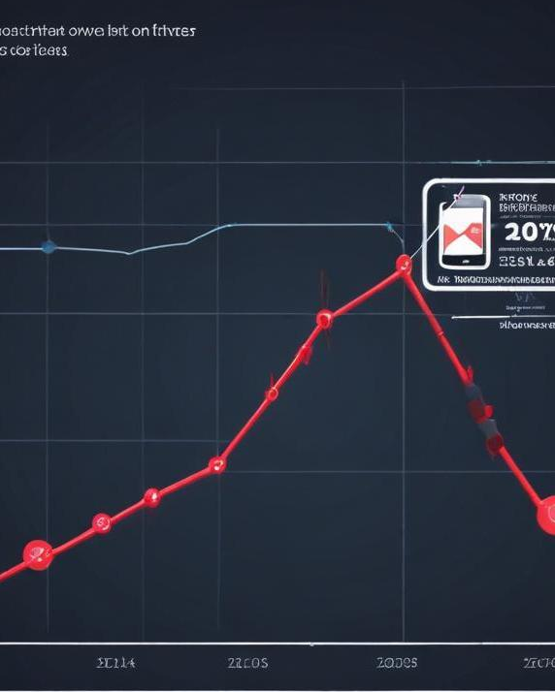
Current Trends in Phishing
Recent trends indicate an increase in targeted phishing attacks using personalized information (spear phishing) and the use of social engineering tactics. Additionally, mobile phishing is on the rise, as attackers exploit the growing use of smartphones for financial transactions and social media activities.

Slide 7
02
Feature Extraction

Slide 8

Types of Features
Key features for phishing detection can include URL characteristics, domain age, website content analysis, and user interface characteristics. These features help in identifying anomalies associated with phishing websites compared to legitimate ones.

Slide 9
Data Collection Techniques
Data for feature extraction can be collected through web crawlers, user feedback, and historical phishing databases. These methods ensure a robust dataset for training machine learning models to recognize phishing attempts accurately.

Slide 10
Feature Selection Methods
Various methods such as Recursive Feature Elimination (RFE), Principal Component Analysis (PCA), and mutual information can be employed to select the most relevant features for improving the model's performance and reducing complexity in phishing detection systems.

Slide 11
03
Machine Learning Techniques

Slide 12
Algorithms for Detection
Various machine learning algorithms can be employed for phishing detection, including decision trees, support vector machines (SVM), random forests, and neural networks. Each algorithm has unique strengths in identifying patterns and anomalies in data.Both supervised and unsupervised learning approaches can be utilized to train models that effectively distinguish between legitimate websites and phishing attempts.

Slide 13
Training Datasets
Training datasets for phishing detection typically consist of labeled data that includes both phishing sites and legitimate sites. These datasets can be compiled from open-source databases, user submissions, and previously collected features. Ensuring diversity in the dataset helps improve the model's ability to generalize and accurately identify new phishing attempts.

Slide 14

Evaluation Metrics
Evaluation metrics used to assess the performance of phishing detection models include accuracy, precision, recall, and F1 score. These metrics help determine how well the model detects phishing sites while minimizing false positives and false negatives. Continual evaluation against evolving threats is essential to maintain detection efficacy.

Slide 15
04
Implementation

Slide 16
Tools and Frameworks
Several tools and frameworks can be used for implementing phishing detection systems, including Scikit-learn for machine learning algorithms, TensorFlow for deep learning models, and various web scraping libraries for data collection. Integrating these tools effectively can facilitate the development of robust detection systems.

Slide 17
Step-by-Step Process
Implementing a phishing detection system involves several key steps: data collection, feature extraction, model selection, training the model, evaluation, and deployment. Each step requires careful consideration and iteration to optimize the system's performance and adapt to new phishing techniques as they emerge.

Slide 18

Challenges and Solutions
Common challenges in phishing detection implementation include handling evolving phishing techniques, ensuring high accuracy without excessive false positives, and managing large datasets. Solutions include regular model updates, advanced feature selection, and deploying ensemble learning techniques to enhance robustness.

Slide 19
05
Case Studies

Slide 20
Successful Detection Examples
Successful detection examples typically include organizations that adopted machine learning techniques to identify and neutralize phishing threats. Case studies often highlight how these organizations used specific algorithms and feature sets to achieve high detection rates and reduce financial losses attributed to phishing attacks.

Slide 21
Lessons Learned
Key lessons learned from implementing phishing detection systems include the importance of continuous learning from emerging threats, the need for regular updates to detection algorithms, and the value of cross-industry collaboration to share insights and improve detection strategies. Understanding user behavior and communication patterns is also crucial.

Slide 22

Future Directions
Future directions in phishing detection include the integration of artificial intelligence for proactive threat detection, improved user education to avoid phishing bait, and the development of adaptive models that learn and respond to new phishing techniques in real-time. Research into behavioral analysis and context-based detection methods is also gaining traction.

Slide 23
Conclusions
Detecting phishing websites through feature extraction and machine learning techniques is vital for protecting users and organizations from cyber threats. The continuous evolution of phishing tactics necessitates ongoing advancements in detection strategies, tools, and user education. By leveraging machine learning and staying ahead of trends, we can significantly reduce the risks associated with phishing attacks.

Slide 24
Thank you!
Do you have any questions?
+91 620 421 838

